Slide 1
Data Science 2 Project

Slide 2
Team Members:
Engy Samy Abo Baker
Aya Sobhy Emam
Aya Ibrahim Abdel Nabi
Mohamed Adel Mohamed

Slide 3
Description of features available in the dataset:
Feature | Description
Airline | The name of the airline.
Date_of_Journey | The date of the journey
Source | The source from which the service begins.
Destination | The destination where the service ends.
Route | The route taken by the flight to reach the destination.
Dep_Time | The time when the journey starts from the source.
Arrival_Time | Time of arrival at the destination.
Duration | Total duration of the flight.
Total_Stops | Total stops between the source and destination.
Additional_Info | Additional information about the flight
Price | The price of the ticket.

Slide 4
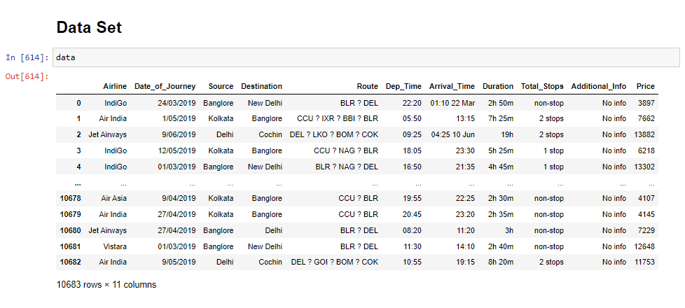

Slide 5
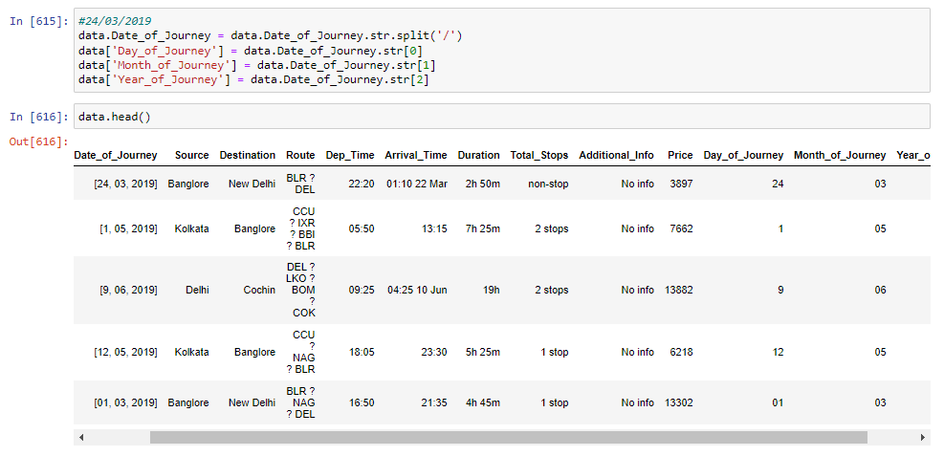



Data Preprocessing
1. Split columns with many value to extract values, and store them in new columns in our DataFrame.
For example
Date_of_Journey
Notes:
In Route column
Total stops max =4 ->6 cities
So a->b ,b->c, c->d, d->e, e->f

Slide 6
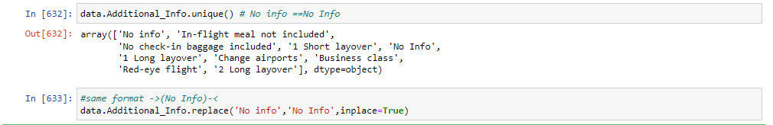
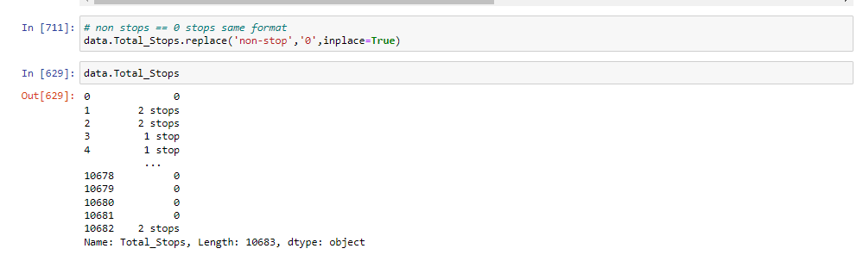
2. Convert inconsistence column value into.consistence one
For example
,Additional_Info,
Totall_Stops

Slide 7
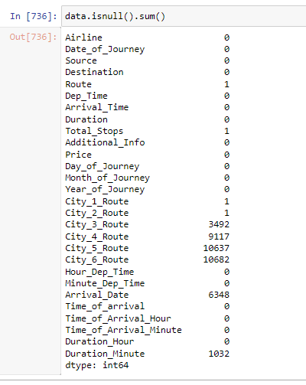


3. delete all the columns from which we have extracted
the useful information
City_6_Route, City_5_Route majority of the data in these columns
was NaN
‘City_4_Route column, since 9117 values out of 10683
rows contain NaN values

Slide 8
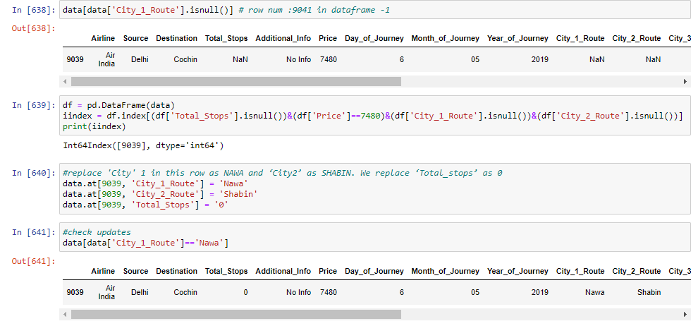
4. Replace missing values
Search for row’ index with ‘nan’ value in City_1_Route then we will find that City_2_Route , Total_Stops columns are ‘nan’ also ,so we will replace
with
Nawa > Shabin
Total ->0
And check update

Slide 9
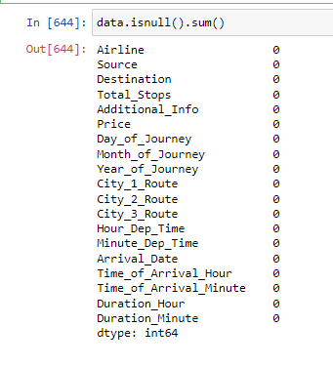
Replace missing values in ‘City_3_Route’ with ‘None’ value,
‘Duration_Minute’ with ‘0’,
‘Arrival_Date’ with ‘Day_of_journey’ column value where flight took off and landed on the same date.

Slide 10
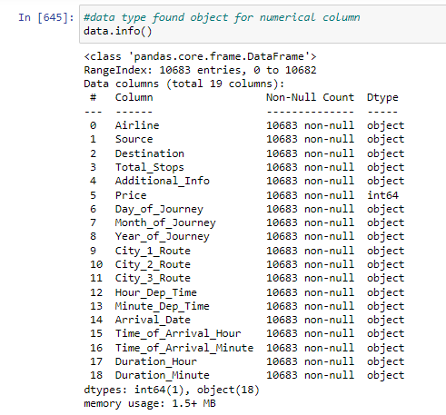
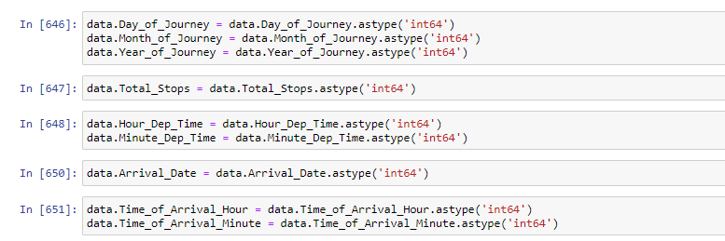













Dataset still has data types for multiple columns as ‘object’ where it should be ‘int64’ so we will change it

Slide 11
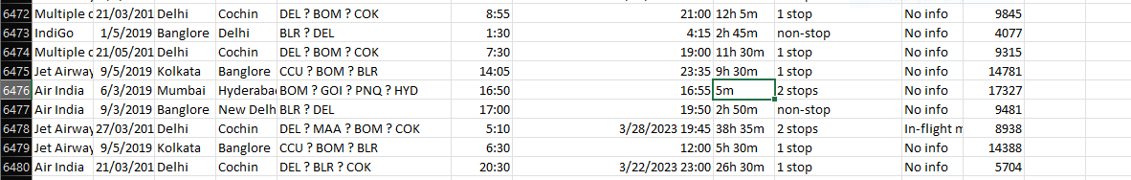
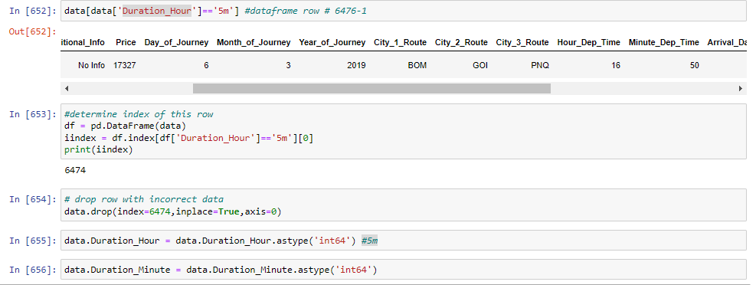





4. Incorrect Data
We will find error with ‘Duration_Hour’ col value’5m’, the plane cannot fly from BOMB->GOA->PUNE->HYD in 5 mins.(The flight has ‘Total_stops’ as 2).So we will drop this
row

Slide 12
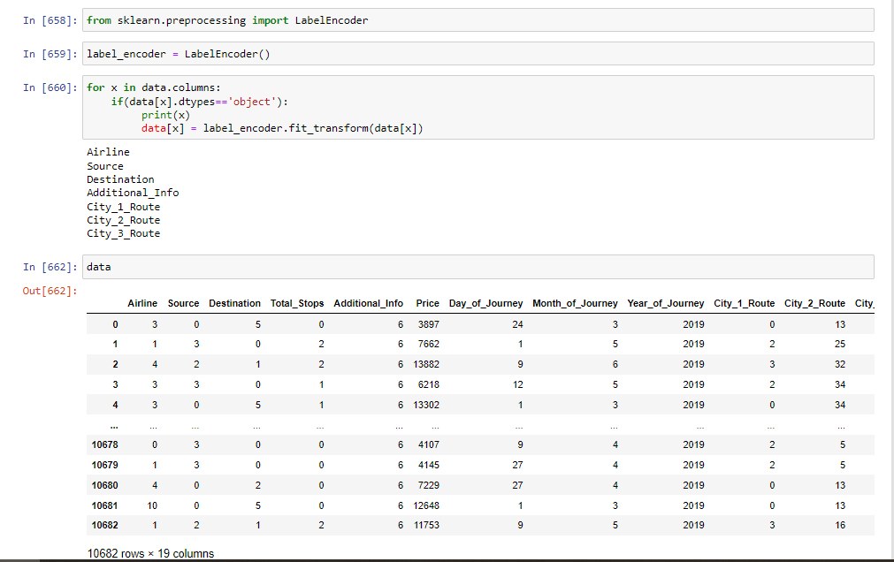
5. Encoding Categorical Data
Columns With Catorical Data are
Airline Source Destination Additional_Info City_1_Route City_2_Route City_3_Route
we will encoding them using LabelEncoder() function in sklearn.preprocessing Library

Slide 13
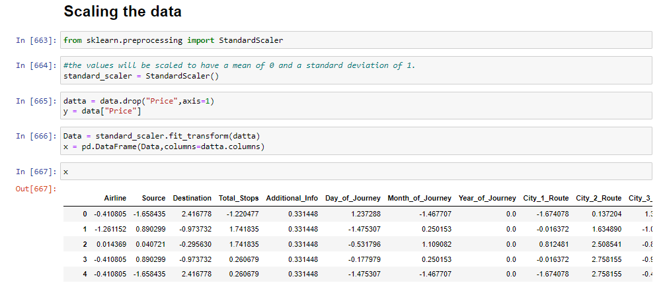
6. Scalling Feature
There exsit some feature columns with very small values and some other with high values. So we will bring them in same scale with mean of 0 and a standard deviation of 1 using StandardScaler() function in sklearn.preprocessing Library
Notes:
Price column is target

Slide 14
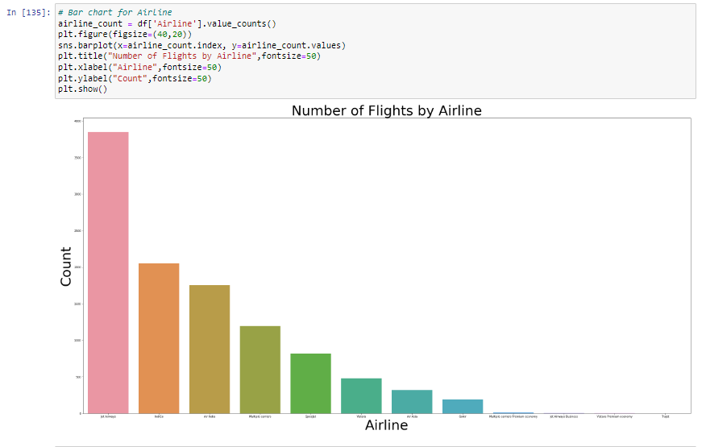
Data Visualization :
Jet Airways is the most preferred airline with the highest row count, followed by Indigo and AirIndia.

Slide 15
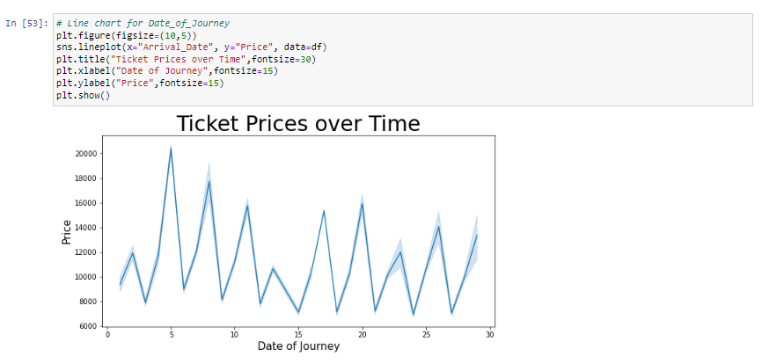
Change of price through Journey’s date.

Slide 16
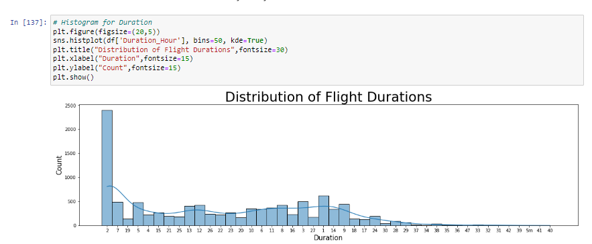

Slide 17
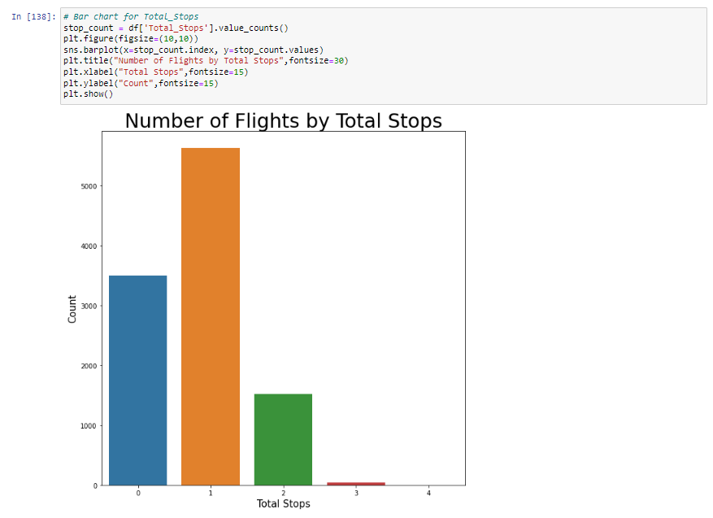
1 Stops is the most common through almost Route from source to destination.

Slide 18
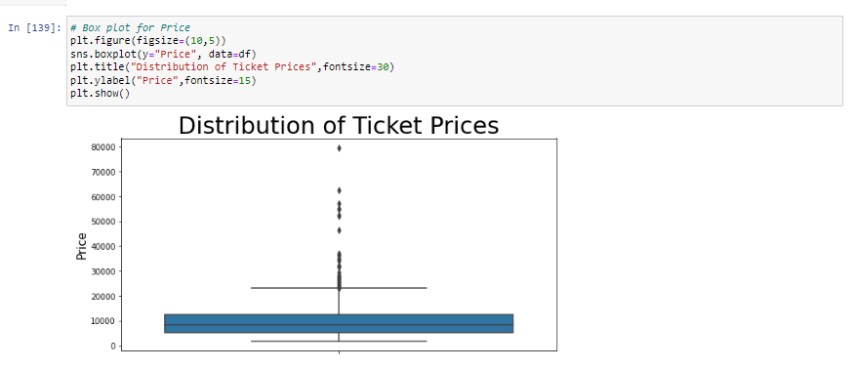
Box plot show statistics of ‘Price’ column with median ~9870
There exist outlier .

Slide 19
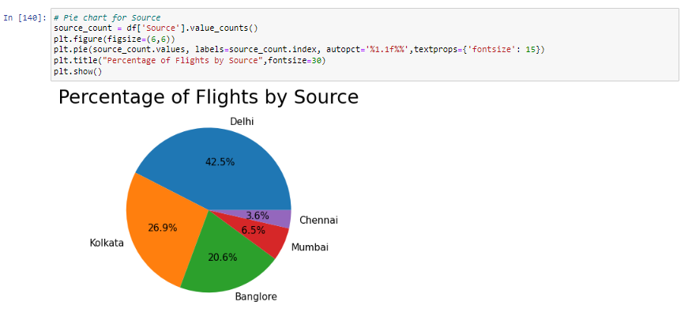
Pie chart shows percentage for certain column for ex ‘Source’
Most the flights start from Delhi city

Slide 20
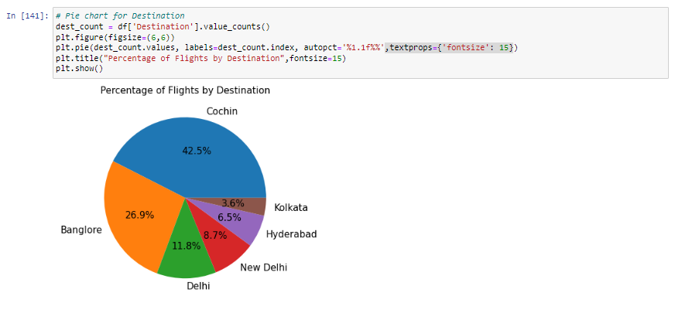
Pie chart shows percentage for certain column for ex ‘Destnation’
Most the flights go to from Cochin city.

Slide 21
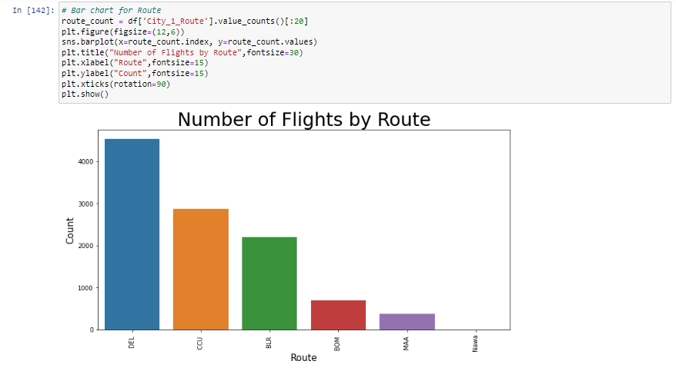
Most city go through during journey is DEL

Slide 22
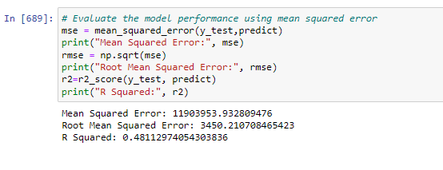
Regression Algorithm:
We tried 3 model to get high accuracy
1st Model
We used LinearRegression() ,get 48% Accuracy

Slide 23
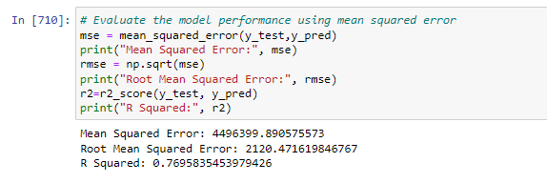
2nd Model
We used KNeighborsRegressor() ,get 76% Accuracy

Slide 24
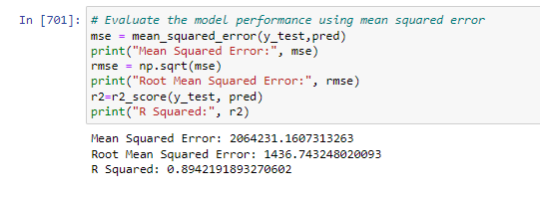
3rd Model
We used RandomForestRegressor() ,get 89% Accuracy

Slide 25
Thank you

